Slide 1




UEFA
Paris
July 2024
2024
Germany (Berlin, Leipzig)n
Transnational Exchange Project
Saxony-Anhalt (Germany)
Centre - Valley of Loire (France)
Orléans
WORKSHOPS
Tours
Prevention of Violence
Germany (Berlin, Leipzig)
Discrimination against woman
Sexual assault
Rassism
Inclusion
Homophobia

Slide 2
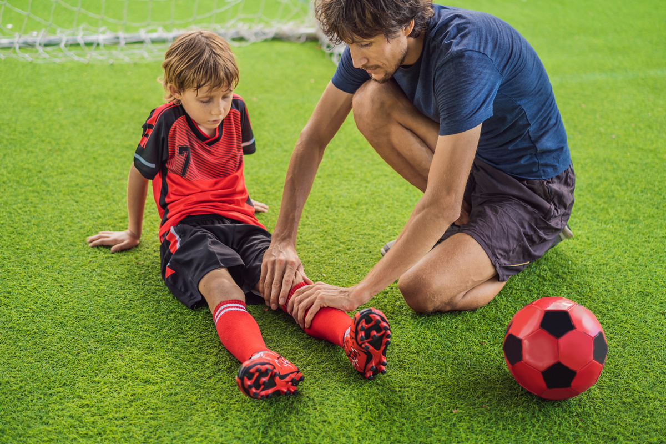




Target group
People getting involved in sports activities during her leasure time
to cherish and recognise their commitment
WHY ?
There are much more people, who are interested in sports than in Europe,
but they can be attracted
Target
Creating feeling and consciousness for Europe by learning from best practise
To encourage people to create twinnings and
European exchange projects

Slide 3



2024
PARTNERSHIP
Sachsen-Anhalt - Centre Val de Loire
Beginning of a structural cooperation between Europe Directs of
Saxony-Anhalt and Centre Val de Loire
European Elections
youth organisations

