Slide 1
Communicating ahead of the European Elections 2024
EUROPE DIRECT centres
Regional training
Budapest, 10-11 October 2023
Jens Mester
Head of Unit, EC COMM.B2
Communication coordinator for the European elections 2024
European Commission, DG COMM

Slide 2
A shared responsability for EU communication

Slide 3
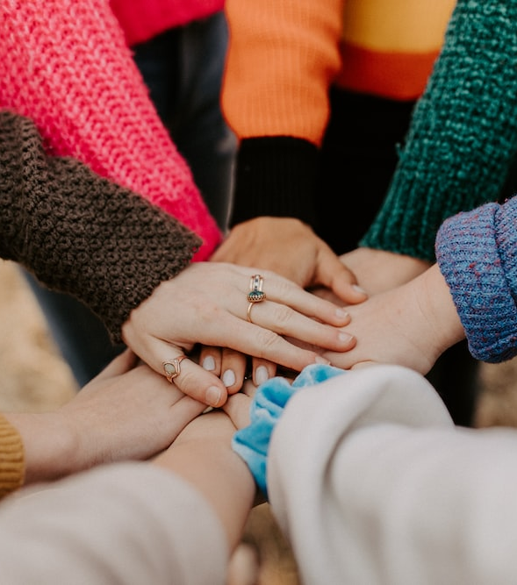
EU institutions, member states at all levels and civil society share a responsibility to communicate about the European Union (cf. Sibiu summit, 2019)
This shared responsibility is particularly engaged ahead of the European elections 2024.
Together we can best promote, strengthen and defend European democracy.

Slide 4
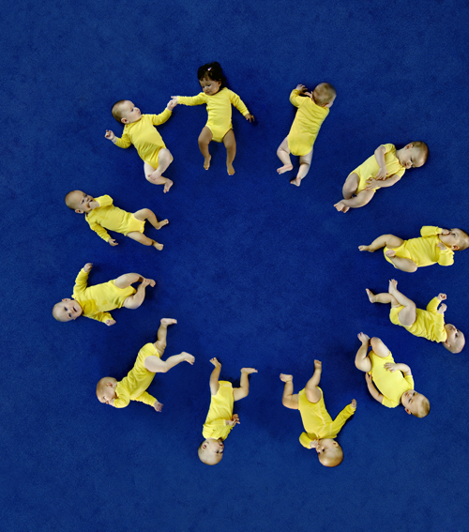
The 2019 European elections saw a significant increase in turnout, which rose to an EU average of almost 51%.
For 2024: Higher awareness, higher interest and higher participation likeliness: the EP Spring Eurobarometer survey results (released on 6 June 2023) show more positive results than a similar survey carried out in 2018.
67% of respondents said they would vote, compared to 58 % in a similar survey in 2018 (whilst actual 2019 turnout was ca. 51%).

Slide 5
2019 European elections – turnout by country
Source: European Parliament/Kantar 2019

Slide 6
Overview of trust levels
How much trust do you have in European institutions:
Source: Standard Eurobarometer 99, Spring 2023

Slide 7
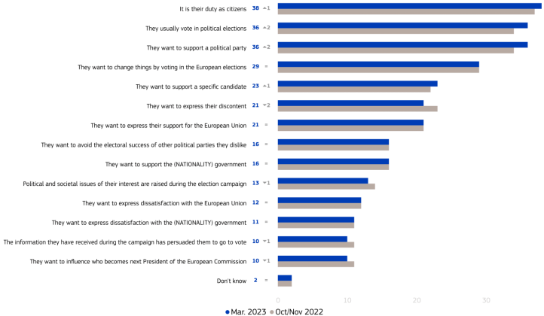
European Union:
Main reasons to vote in the 2024 European elections
Source: EP Spring 2023 Survey: Democracy in action - One year before the European elections

Slide 8
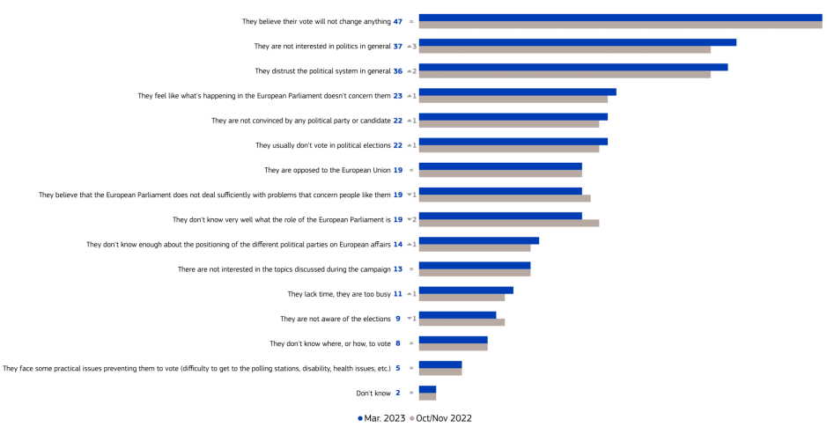
European Union:
Main reasons not to vote in the European elections? (EU27) (%)
Source: EP Spring 2023 Survey: Democracy in action - One year before the European elections

Slide 9
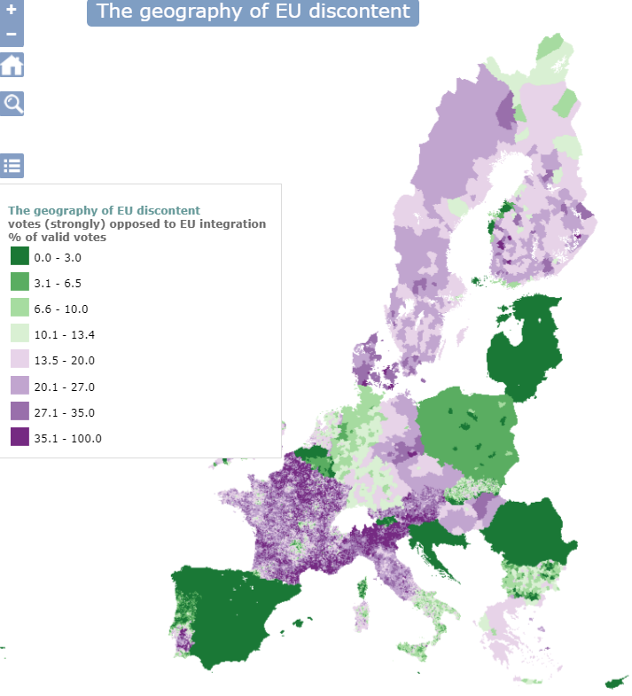
Geography of Discontent
The results show that economic and industrial decline are driving the anti-EU vote.
The longer a region is caught in a regional development trap, the greater is the impact on Eurosceptic voting
Areas with lower employment rates or with a less-educated workforce are also more likely to vote anti-EU.
The Geography of EU discontent and the regional
development trap, 2023
Andrés Rodríguez-Pose, Lewis Dijkstra and
Hugo Poelman

Slide 10
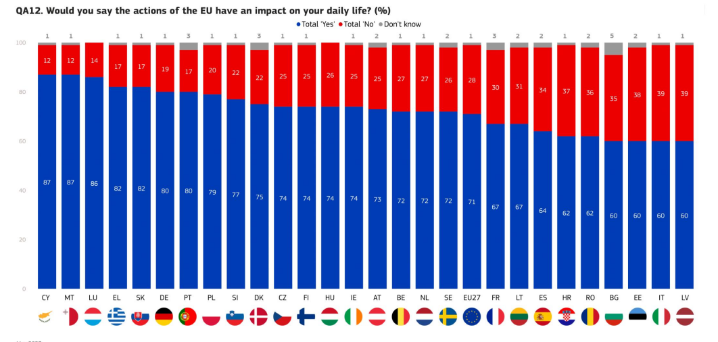
At least 8 in 10 citizens say the EU’s actions impact their daily lives in 7 MS
Source: EP Spring 2023 Survey: Democracy in action - One year before the European elections

Slide 11
Higher awareness of EU impact = higher likeliness to vote
Source: EP Spring 2023 Survey: Democracy in action - One year before the European elections

Slide 12
Elections-related communication:
Objectives, areas and resources

Slide 13
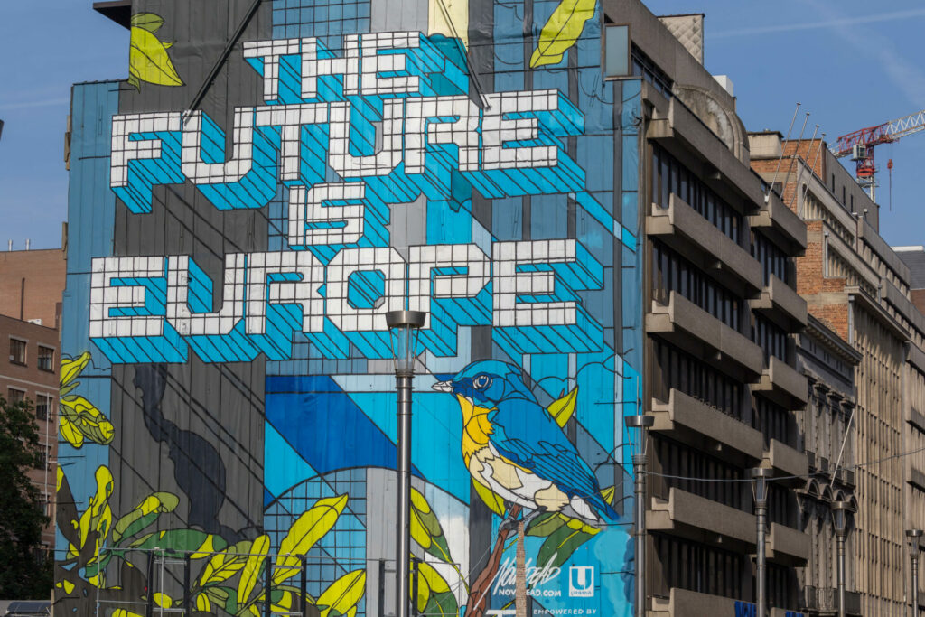
Objectives
inform citizens about the European Union and the elections, based on facts
engage citizens in European democracy…
…to empower them to make informed decisions about Europe’s future.
There are more than 400 000 000 eligible voters out there !!!
We need to work together to get out the vote and to….

Slide 14
…support „candidate Europe“

Slide 15
Our 6 areas of action and cooperation
Communicating EU delivery
  What the EU stands for
  What the EU does for citizens
  What the EU does with citizens
Fighting elections-related mis-and disinformation
Informing about the elections and voting rights
Supporting the EP’s ‘Go-to-vote’ democracy campaign (2024)
Activating our networks and partners
Empowering and engaging staff

Slide 16
1 - Communicating EU delivery
What the EU does for and with its citizens and what it stands for

Slide 17
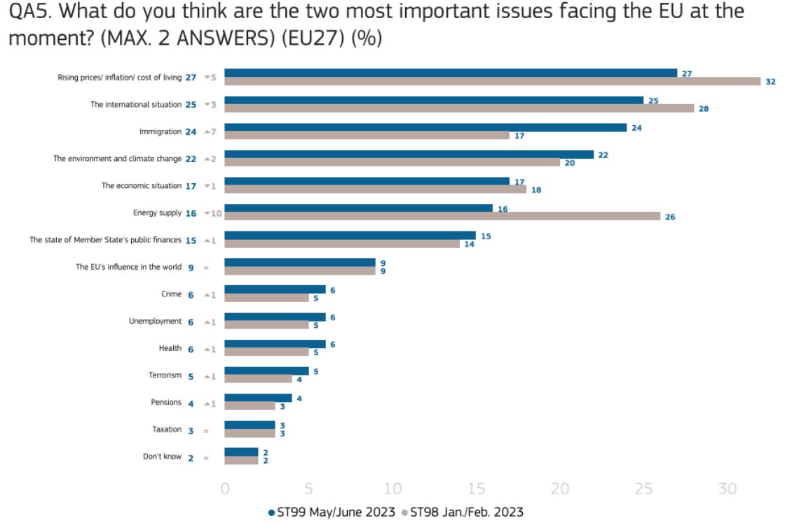
Rising prices/ inflation/ cost of living is considered the most important issue faced by the EU, followed by the international situation and immigration
Source: Standard Eurobarometer 99, Spring 2023

Slide 18
Key concerns in selected countries
Source: Standard Eurobarometer 99, Spring 2023

Slide 19
What you can do (1/2)
What to communicate: EU delivery and achievements in the current mandate (cf. State of the Union), in its 3 dimensions (delivery for and with citizens and actions that illustrate EU values), with localised examples and human stories that resonate with the audience and reach hearts and minds.
Who to target? Focus on those who can make a difference in line with the EP’s data-driven approach namely ‘EU active enthusiasts” and ‘EU engaged ambivalents’ as well as young people/ first time voters.
How to present it? Make largest possible use of EU branding/EU emblem, except when it is purely a Commission initiative. Use the ‘democracy in action’ tagline and hashtag wherever possible.

Slide 20
What you can do (2/2)
Include European elections 2024 as communication priority in your Annual Communication Plan (ACP) for 2024 that you have been invited to submit by the EC Representation
Take into account the elements shown in the slides when drafting your ACP proposal, following the indications of the Representation
Stay in close contact with your network correspondent regarding emerging communication needs.

Slide 21
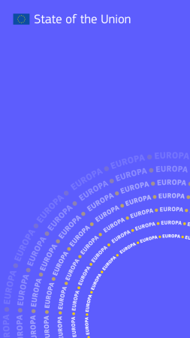
State of the Union 2023
SOTEU webpage
State of the Union 2023 – Achievements 2022-2023
State of the Union 2023 – Timeline
State of the Union 2023 - President von der Leyen's letter of intent
Visual story “Promises kept“
Defending European peace
Investing in Europe’s prosperity
Building Europe’s societal resilience
Your Europe, Your stories
2023 State of the Union - Main initiatives

Slide 22
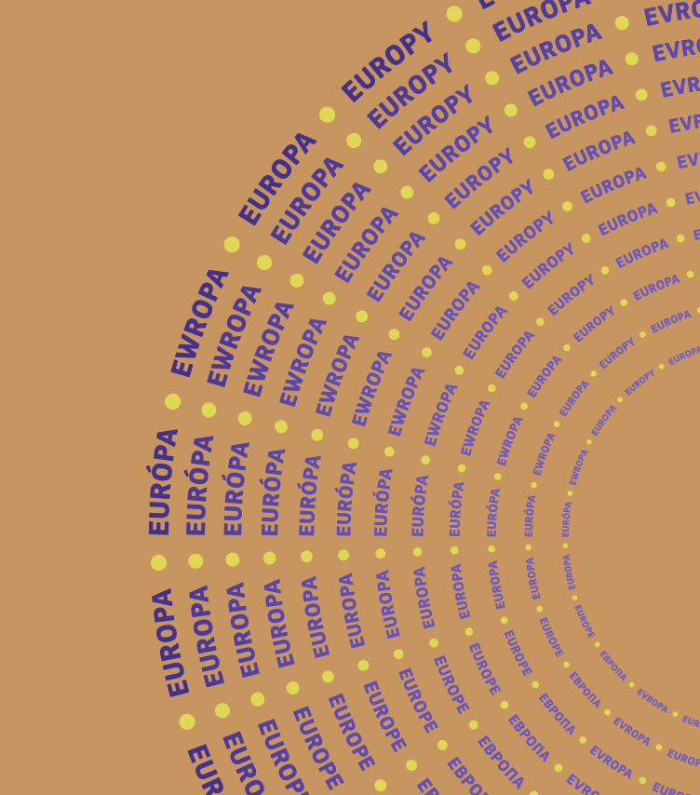
Websites
Addressing particular concerns of citizens:
Commission priorities and policy action
EU Solidarity with Ukraine
NextGenerationEU
REPowerEU
European Green Deal and the Green Deal Industrial Plan / clean tech revolution
EU action to address the energy crisis
Home affairs / migration and asylum
An economy that works for people
Tackling online disinformation
The EU in 2022 – General Report

Slide 23




Projects and stories about EU benefits – make them visible!
RRF-projects online map
The key instrument at the heart of NextGenerationEU with updated projects in the Member States
Kohesio knowledge base of projects
Discover EU projects in your region
EP-What Europe does for me
(EP/EC discussions on-going to ensure up-to-date information)
EU in my region
Show what is made possible locally in the regions though EU actions

Slide 24


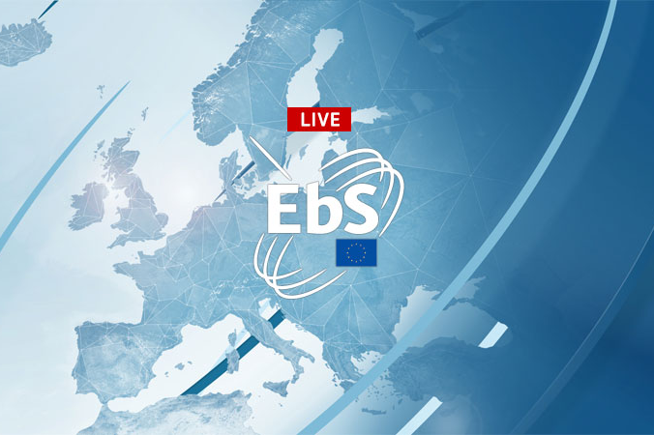
Press, social media, audiovisual
Press releases
Social media
EC general channels
Social media wiki
Audiovisual Portal
Free photo and video material

Slide 25
2 - Fighting elections-related disinformation

Slide 26
Our goal and strands of action
Our goal: ensure that the democratic process remains robust, resilient, transparent and trustworthy. When fighting disinformation it is incumbent upon us all to occupy the information space with facts not fallacies and to limit public exposure to harmful content through the following strands of action:
By pushing major online platforms to actively work towards putting in place effective measures that reduce the spread of harmful disinformation online and hence reduce the need to fight it, e.g. via self-regulation, EU regulation and other measures. Examples: EU Code of Practice on disinformation, Digital Services Acts (DSA), strengthening audio-visual media regulators.
In communication terms: by pro-actively promoting our own message, multi-channel and in a coordinated manner - also key during crises; by exposing fakes and underlying mechanisms; and by increasing media literacy.
By building resilience (raise awareness through cooperation with civil society, schools, etc.) and enhance media and digital literacy,

Slide 27

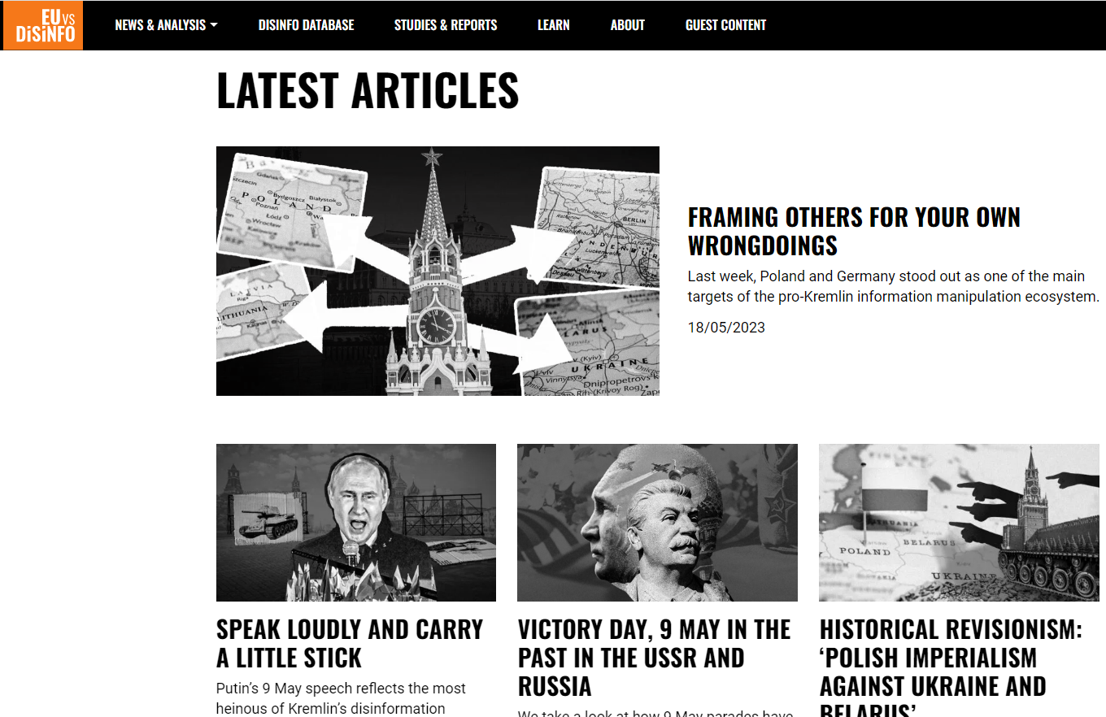
What you can do
Spread proactively positive narratives and examples of EU delivery.
Convey correct information about EU democracy (on the EU’s democratic system and legitimacy, electoral processes, registration deadlines, elections dates)
Build resilience by increasing awareness and media literacy
Work with fact-checkers (media, European Digital Media Observatory (EDMO), etc.)
Expose fakes and underlying mechanisms
Report suspicious stories and posts to your ED Network Correspondent
https://euvsdisinfo.eu

Slide 28

Resources against mis-/disinformation
  EU vs. Disinfo (European External Action Service)
  Code of Practice on Disinformation
  EU Regulation: The Digital Services Act (DSA)
  Positive communication assets on the EC Social Media Wiki
  Guidelines for teachers and educators on tackling disinformation online - Social Media Working Group published 4 - 11 September 2023 on the EC Facebook page and taken up by Reps accounts in member states
  The Learning Corner

Slide 29
3 - Informing about
European elections

Slide 30

The European elections are important because….
…they give you the chance to select who will represent you in the European Parliament.
Your vote influences Europe’s future course and the decisions the Union is taking to address your concerns.
There are plenty of such decisions taken democratically at EU level.
You have the right to vote in the elections but also stand as a candidate!
A high turnout increases Europe’s democratic legitimacy and strengthens our democratic resilience.

Slide 31
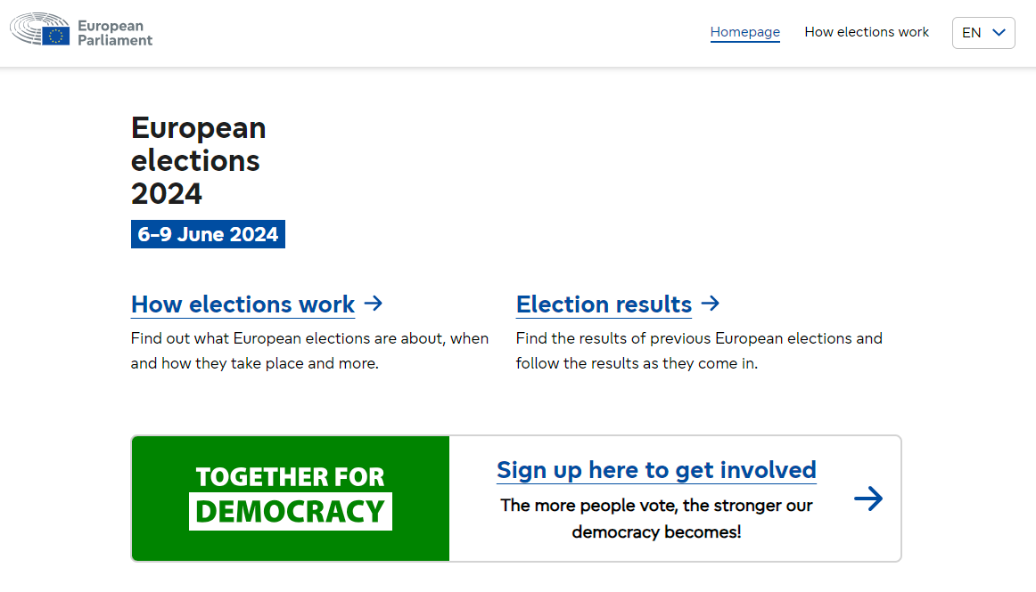
European Elections 2024 website
The EU’s one-stop hub on the European elections (EP, with support of EC):
https://elections.europa.eu/en/
Key features include:
Section: How European elections work
Section: Elections Results
Section: How to vote (forthcoming)
Link to get involved via together.eu
Links to the political groups and to the European political parties
Equal access to information for all users
Citizens’ elections helpline

Slide 32

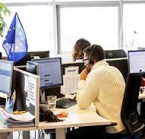
Citizens‘ Elections Helpline
(of the EU‘s contact centre)
It answers citizens’ questions on all EU-related matters
It acts as the European elections helpline.
New video clip (30 sec) soon available in all EU official languages
Write us by email or chat:
https://europa.eu/european-union/contact_en
Call from EU countries:
00 800 6 7 8 9 10 11 (free phone)
Call from other countries:
0032 2 299 9696 (standard international rate applies to the call)

Slide 33

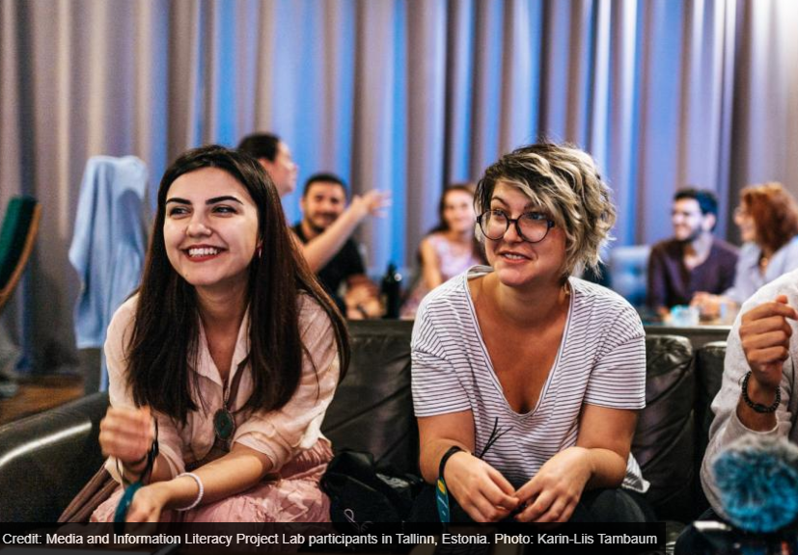
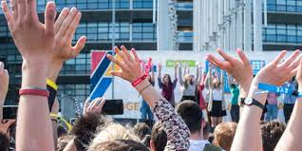
Young people and first time voters
Learning corner
Games, competitions and publications for youngsters to discover the EU, in the classroom or at home.
Youth Portal
To invite young people to find ways to take action as a European and a global citizen
Leaflet for young people
on democratic engagement (forthcoming)

Slide 34
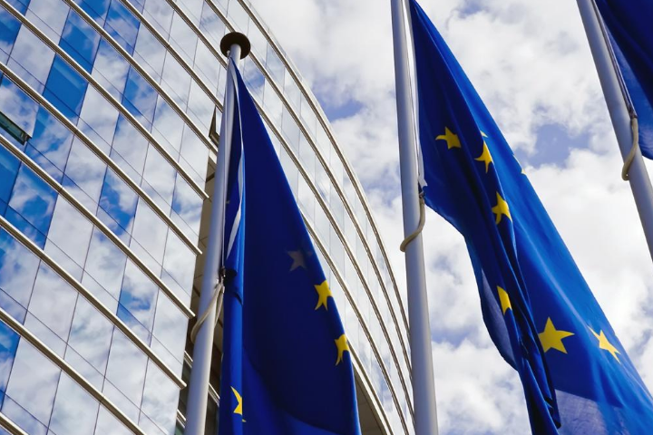

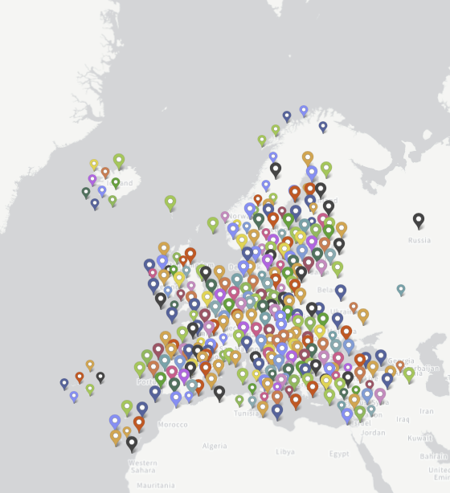
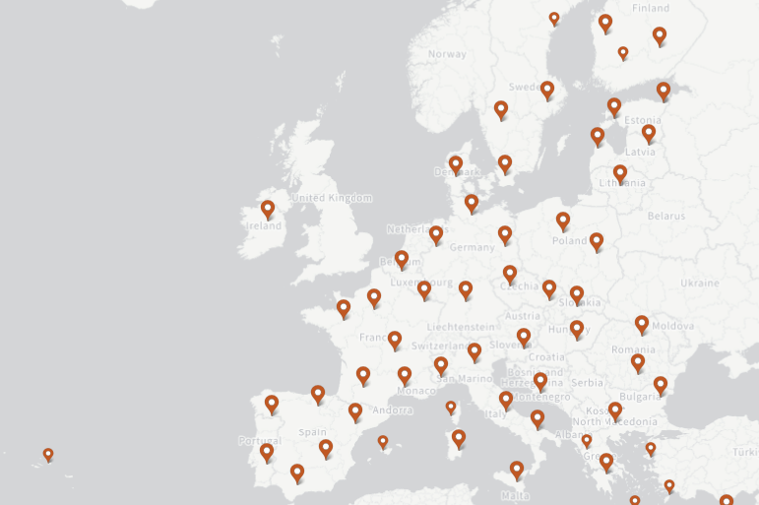
EU presence on the ground in Member States
Commission Representations in Member States :
connecting with national, regional and local authorities
providing the Commission with political information and analysis
communicating to various audiences
European Parliament Liaison Offices (EPLOs) objective is to raise awareness among people about the European Parliament's influence on their daily lives and encourage greater participation in the European democratic process.
‘European Union around me’ map to locate the EU centres active in your region and find out about the services they provide.
EUROPE DIRECT Centres help bring the European Union closer to people on the ground and help facilitate their participation in debates on the future of the EU.

Slide 35

What you can do
Speak of ‘European elections’ not ‘EP elections’ to underscore the importance for Europe’s future. Use hashtags #EUelections, #EUElections2024 or #EuropeanElections.
Get young people/first time voters interested in the EU and the elections.
Promote information ressources like the elections website, the elections helpline and the EU’s presences on the ground.
Disseminate the EU youth leaflet (forthcoming) about democratic engagement and inform about various opportunities for young people, e.g. via the EU Learning corner and the EU Youth portal.
Plan activities with local schools and youth organisations
Promote together.eu via the unique referral link for Europe Direct network: https://together.europarl.europa.eu/en_GB/referral/rcE114099475
Promote the « Back-to-school/back-to-university scheme »

Slide 36
4 - Supporting the EP’s
‘go-to-vote’ campaign in 2024

Slide 37
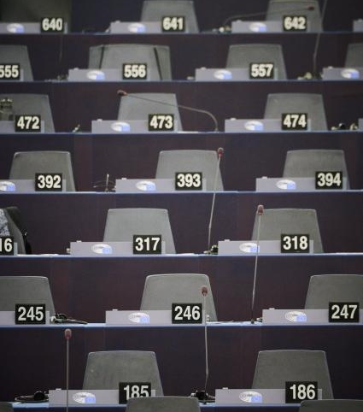
What you can do
Help amplify the EP’s go-to-vote campaign after its launch in April/May 2024
Cooperate with Reps/EPLOs to this end.
Cooperate with regional and local authorities to this end.
Further guidance will follow.

Slide 38
5 - Activating our networks and partners

Slide 39
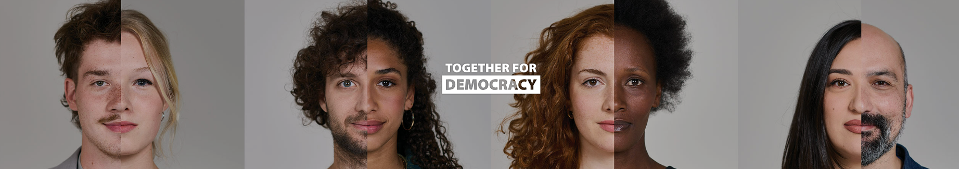
Together.eu is a community of people who believe in democracy and who want to give it real meaning as the next European elections approach.
It is a platform created by the European Parliament for democratic engagement
It connects people from across Europe to meet, share knowledge and learn new skills, all while encouraging others to vote in 2024.
It contains a download/resources centre with materials that everybody can use
It offers different levels of engagement and a reminder function for the elections.
The Commission has committed to help promote together.eu and grow the community.

Slide 40
What you can do
Help grow the together.eu community and encourage citizens to register under the following referral link created for the Europe Direct network: https://together.europarl.europa.eu/en_GB/referral/rcE114099475
Help mobilise networks and multipliers such as celebrities, content creators, public/private organisations, local media, beneficiaries of EU funding to spread the word about the elections and speak up for Europe. (Modalities will follow).
Cooperate with regional/local authorities and other networks

Slide 41
6 - Empowering and engaging staff

Slide 42
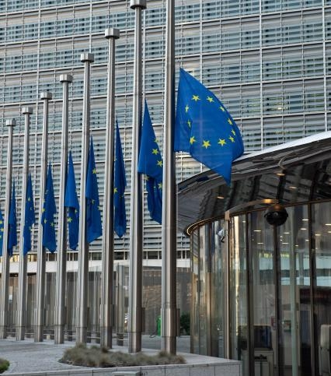
What you can do
Facilitate Back-to-School/Back-to-University of EU staff.
Inform and engage colleagues in your EUROPE DIRECT centre.
And don’t forget to vote yourself!

Slide 43
Let’s discuss your needs!

Slide 44
Slido question: What would you – the communicators – need from the EU institutions to support you in your efforts to activate voters? (up to 5 choices possible)
To answer please go to: https://www.slido.com/
Information about achievements and latest developments in key policy areas
Information about how to engage in European democracy
Information about the European elections, voting rights and modalities
A single website on the elections and information about electoral rights
Infographics / visual communication materials
Customisable social media assets on policies and the elections
Audiovisual explainers on policies and the elections
A multilingual citizens helpline to ask questions about the elections and the EU
Materials to uncover disinformation techniques and fakes and enhance media literacy
Materials in simple language for younger and older audiences
Games, quizzes, cartoons about the EU and the elections
Project examples and stories from EU-funded projects
Local events and debates about the EU
All of it

